Slide 1
Online Banking Application

Slide 2
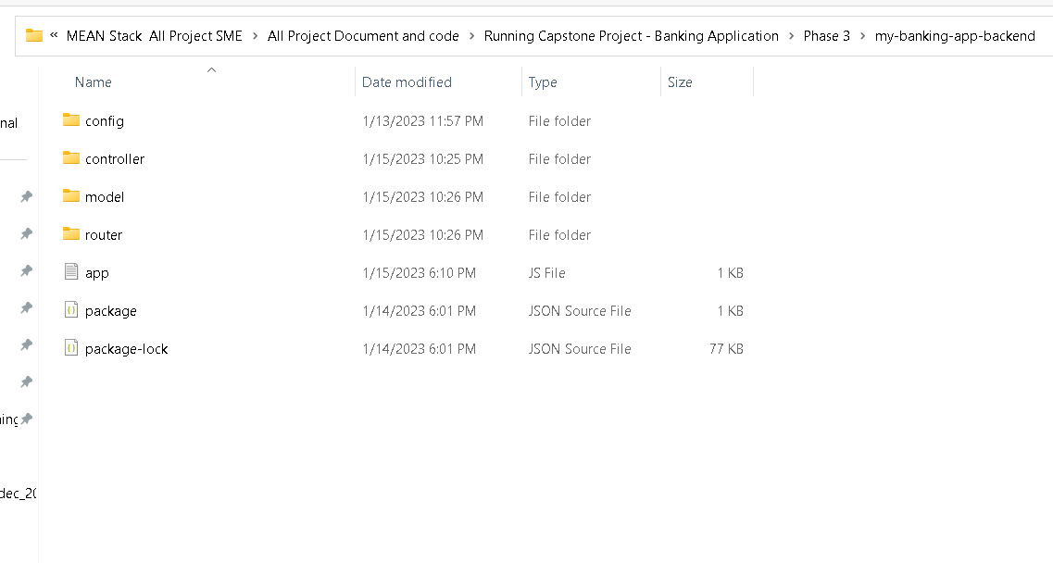
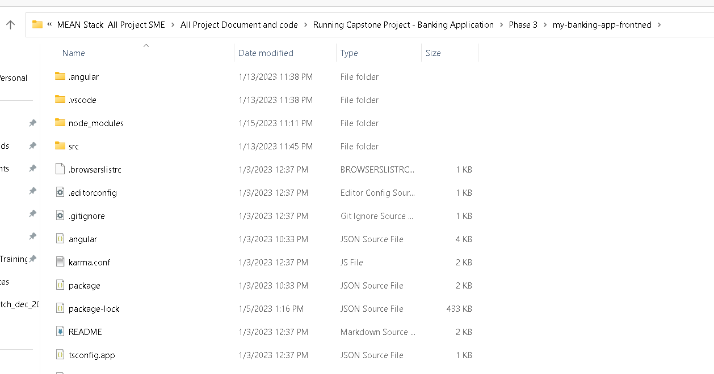
In both backend and frontend project
You run the npm install command to download the dependencies.

Slide 3
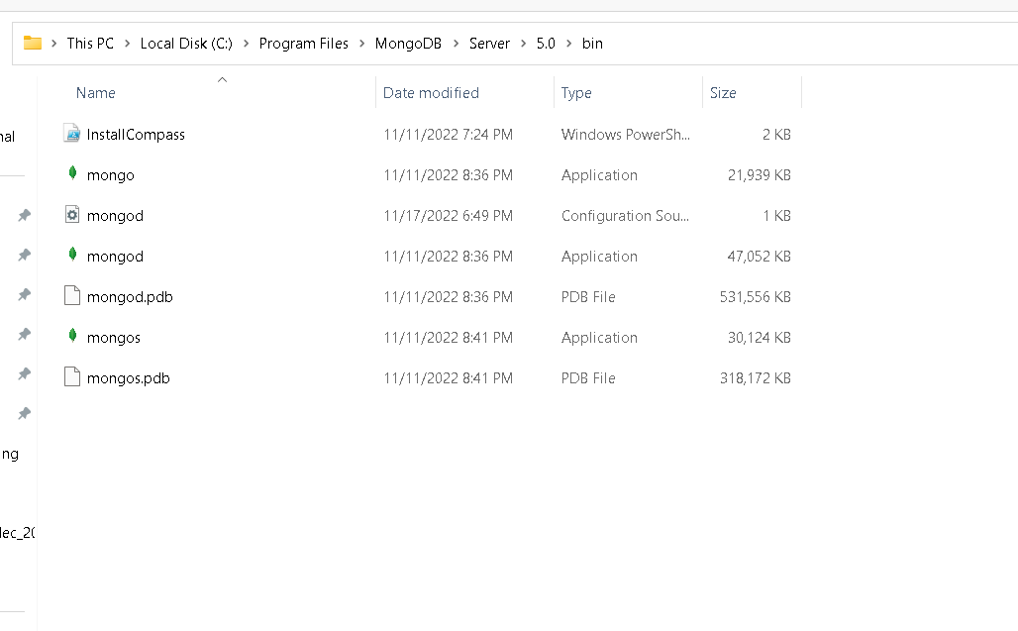
First install mongo db in your machine

Slide 4
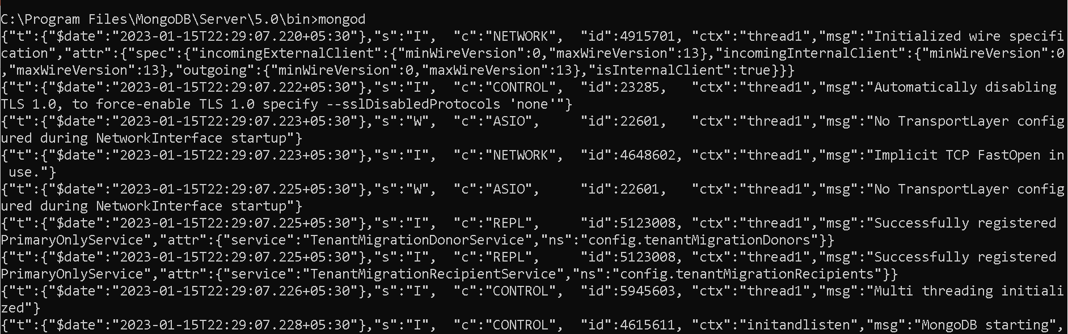
First run mongo db database

Slide 5
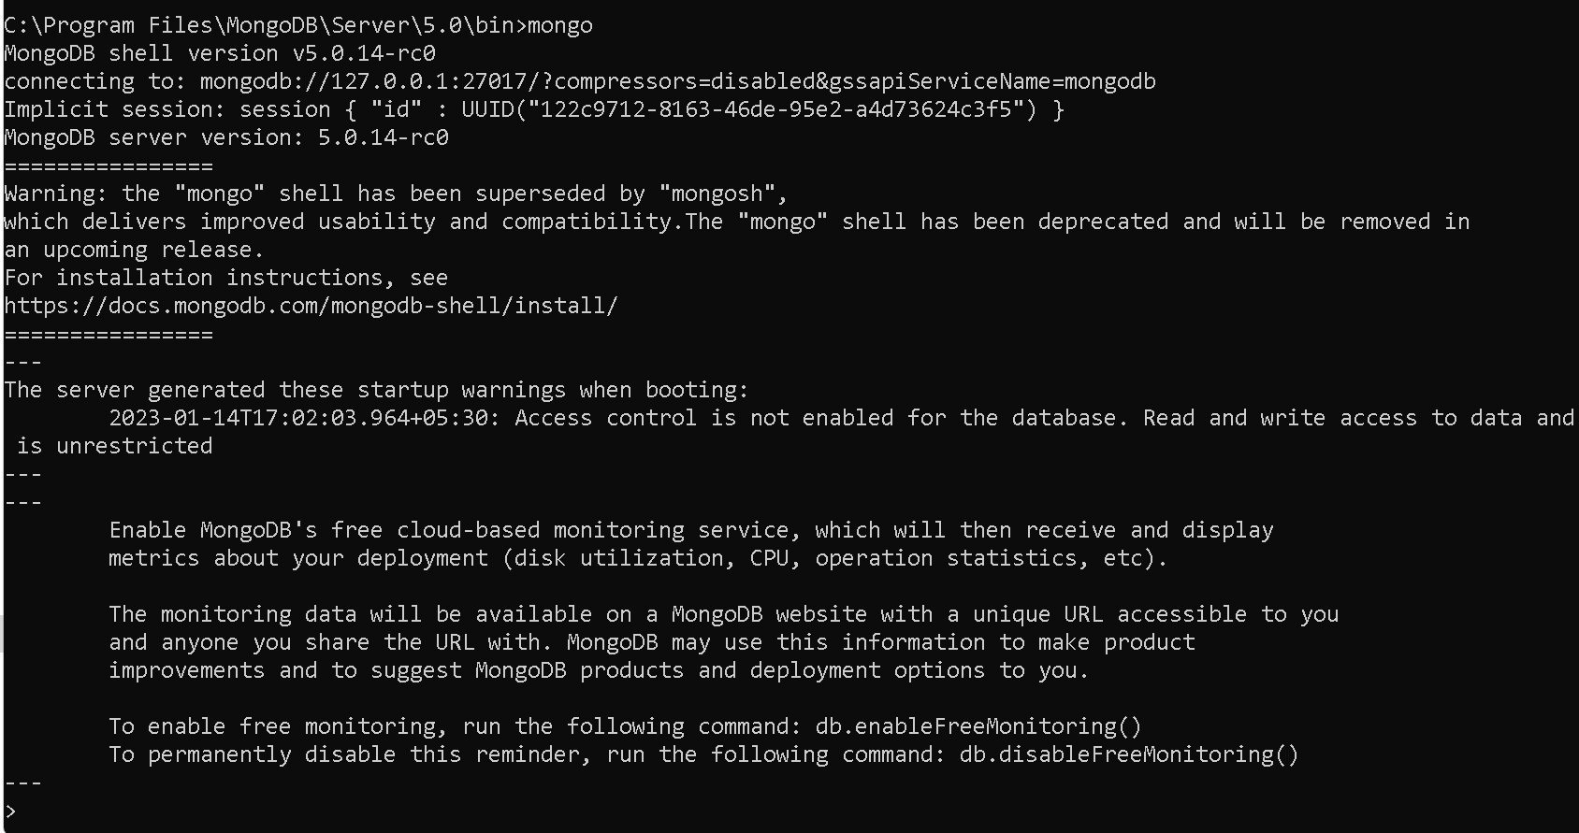
Run mongo terminal

Slide 6
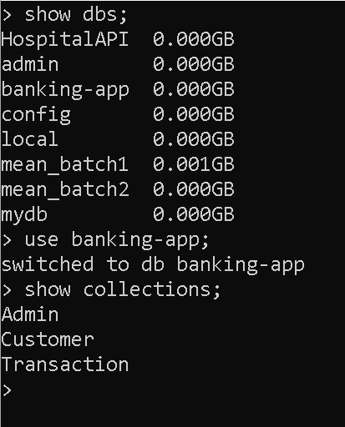
In mongo db database in terminal

Slide 7
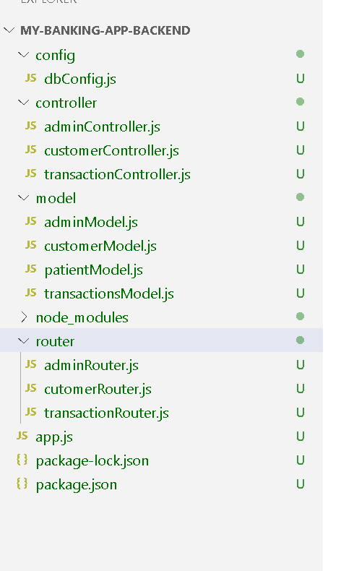
Now open express js project structure

Slide 8
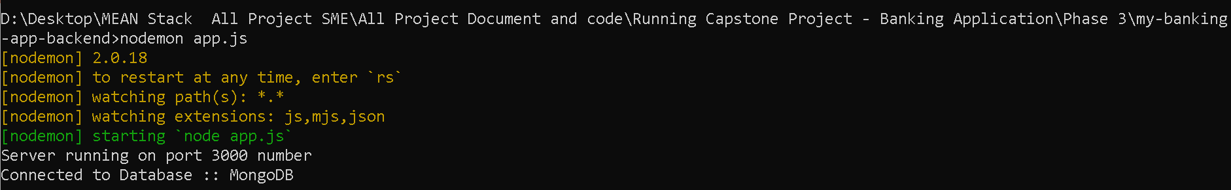
Now we run this application using command as
node app.js or nodemon app.js

Slide 9
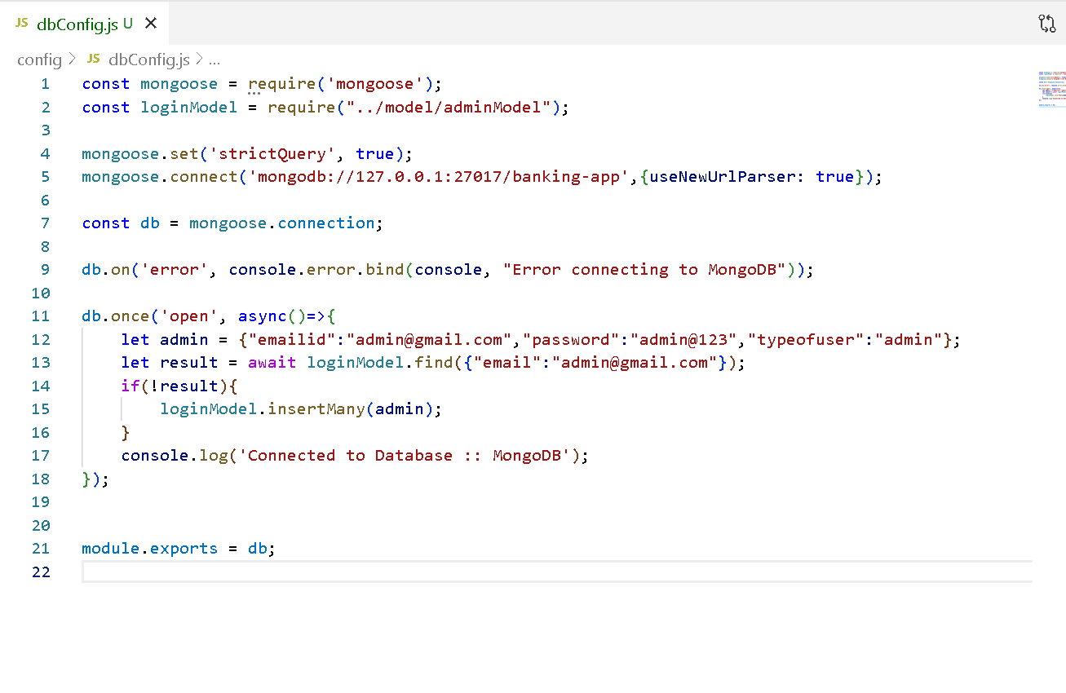
Sample dbConfig.js: it will connect database and create admin account

Slide 10
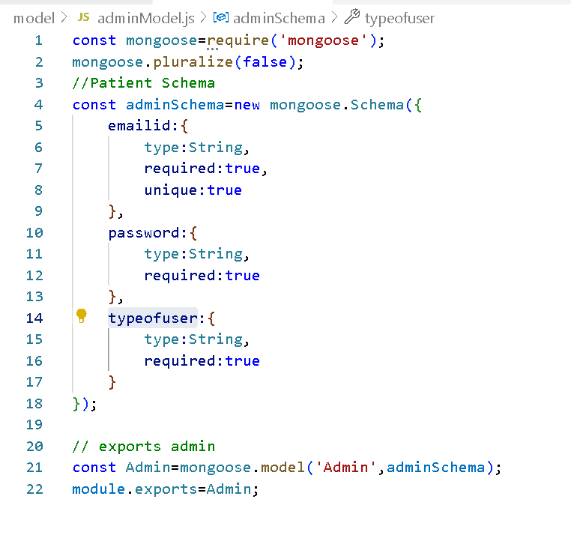
adminModel.js

Slide 11
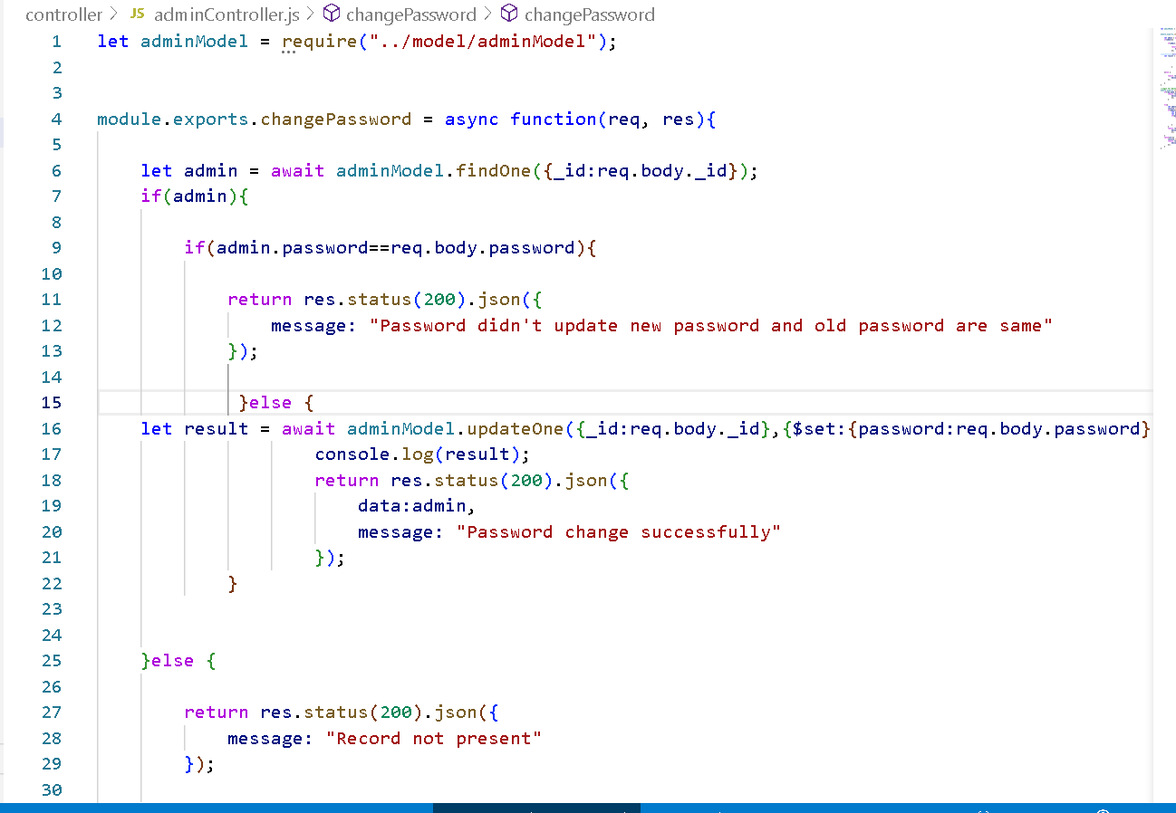
adminController.js

Slide 12
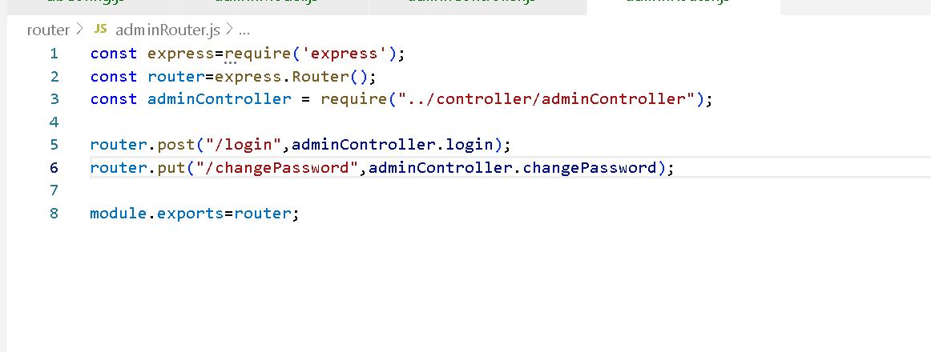
adminRouter.js

Slide 13
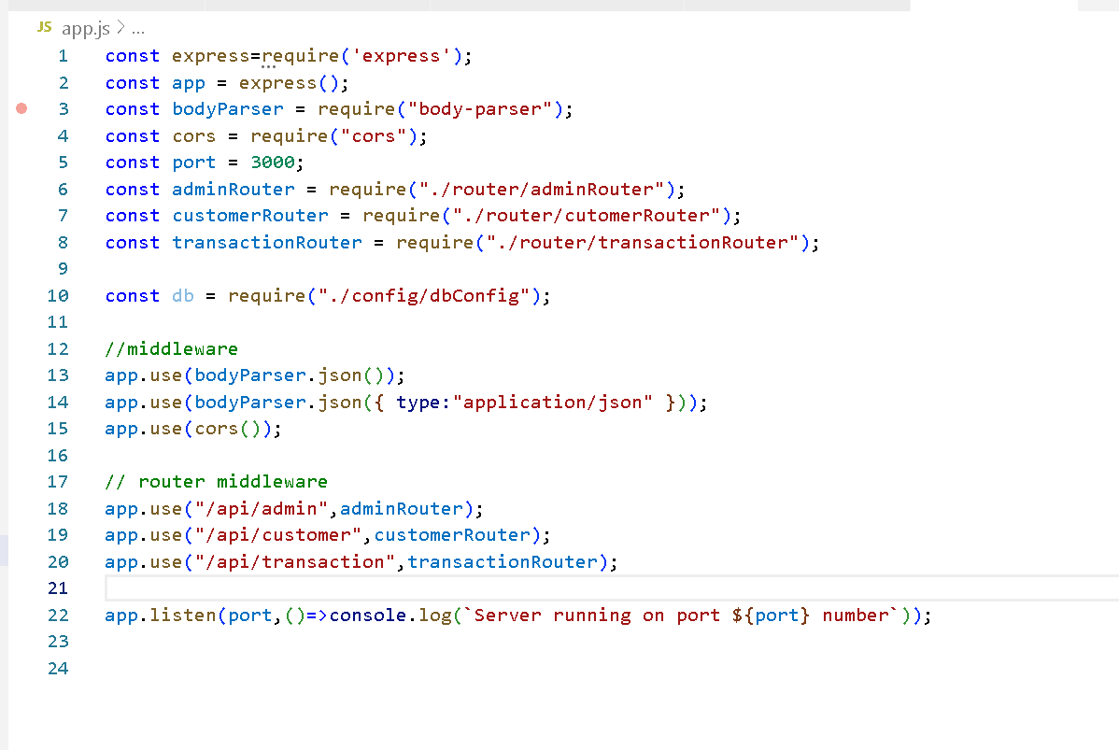
App.js

Slide 14
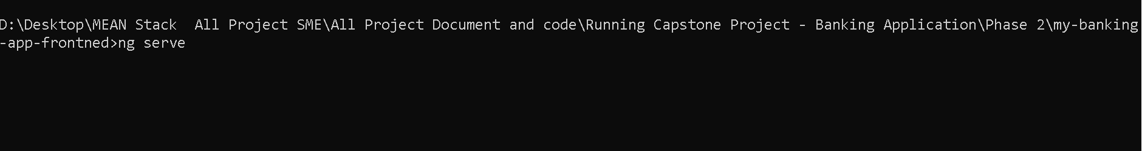
Run the angular project
Ng serve (project name is my-banking-app-frontend)

Slide 15
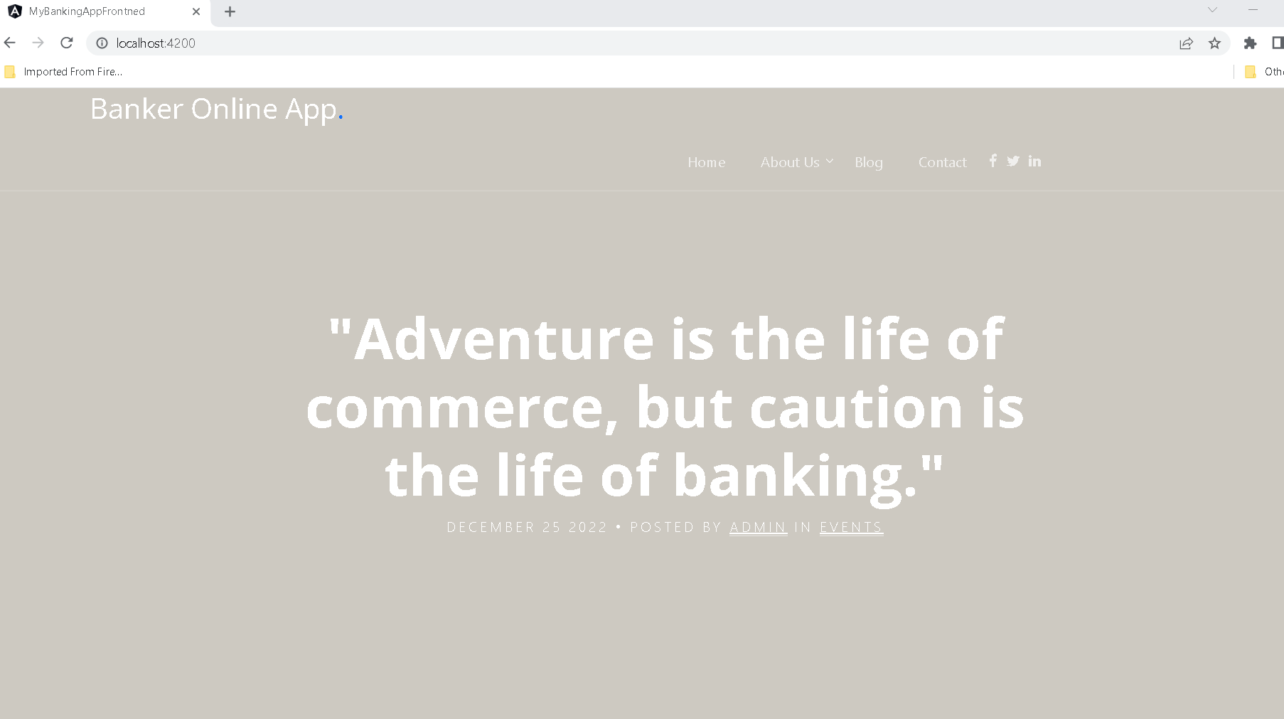
Online banking application landing page

Slide 16
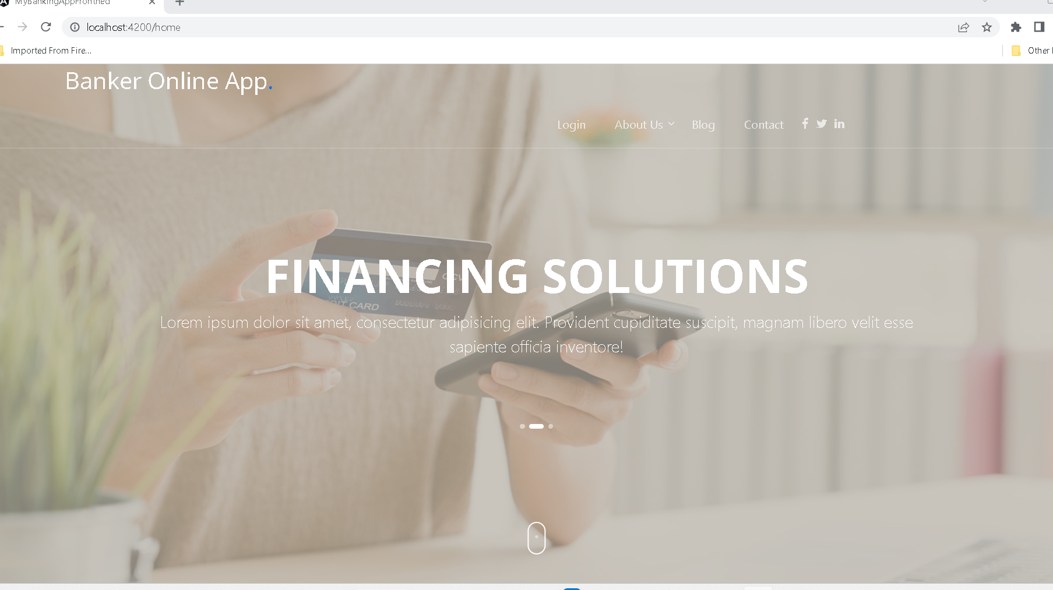
After click home link

Slide 17
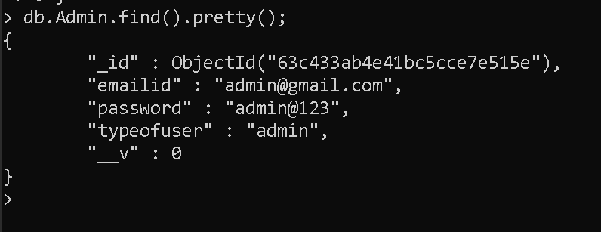
Mongo db collection in admin

Slide 18
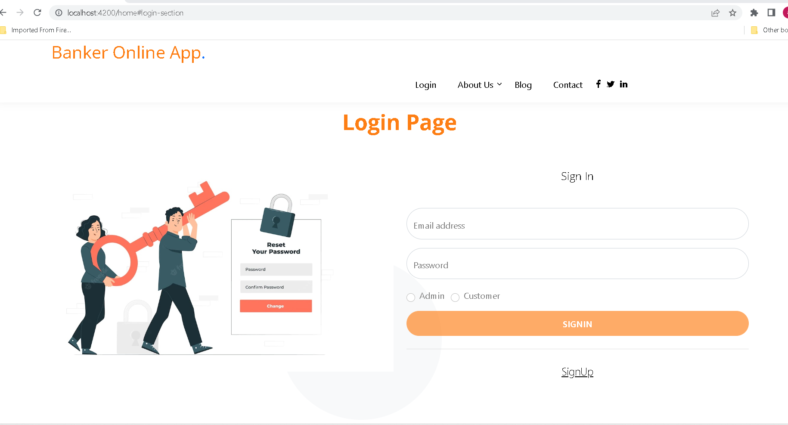
After click on login

Slide 19
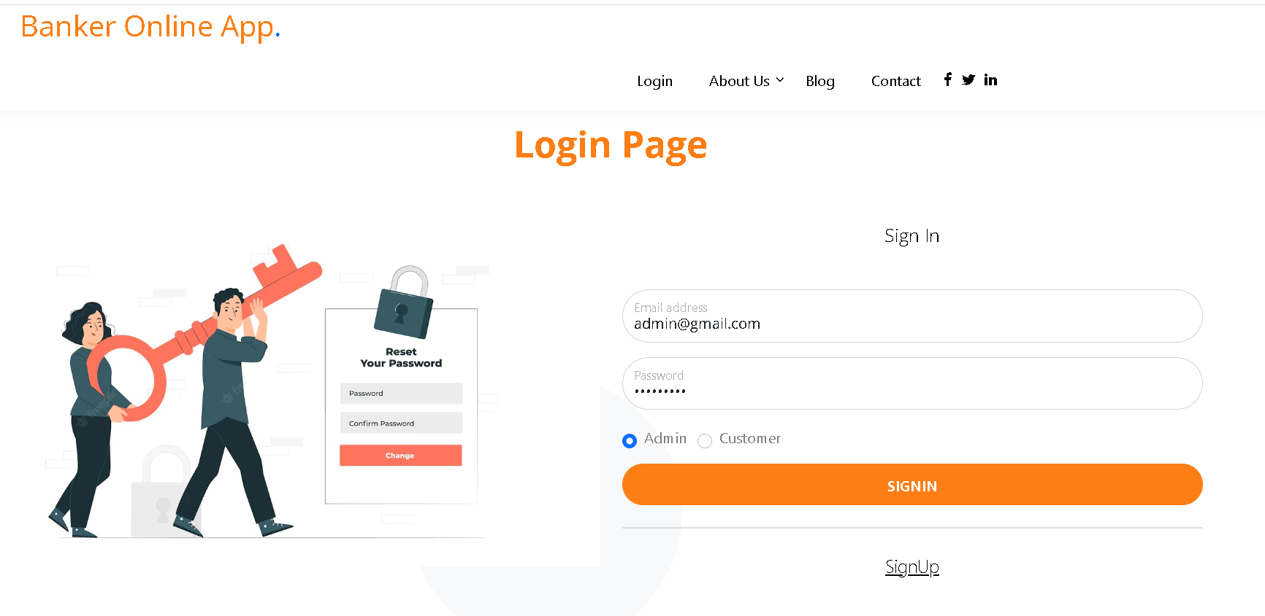

Slide 20
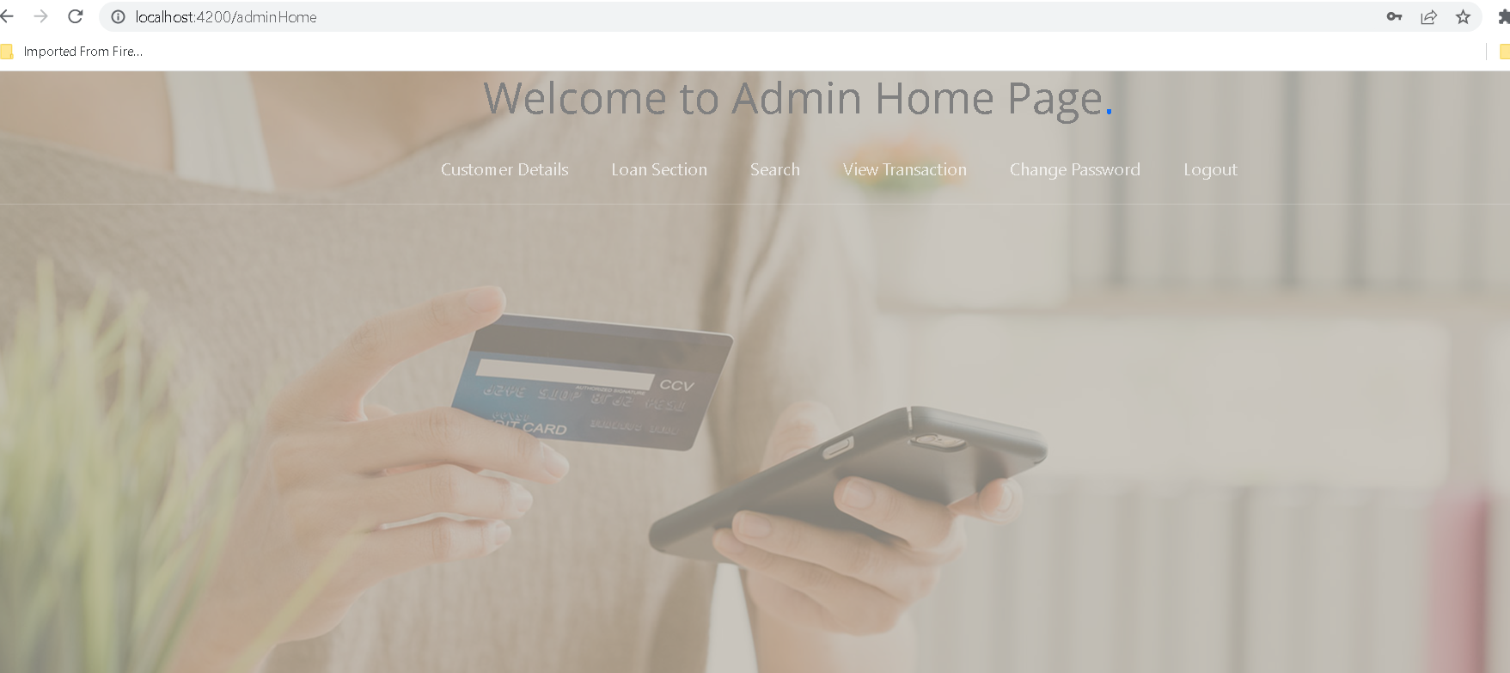
Admin home page

Slide 21
Now click on logout

Slide 22
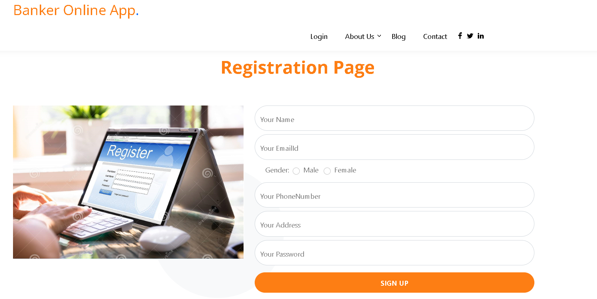
Now we will create the customer account. So click on signup

Slide 23
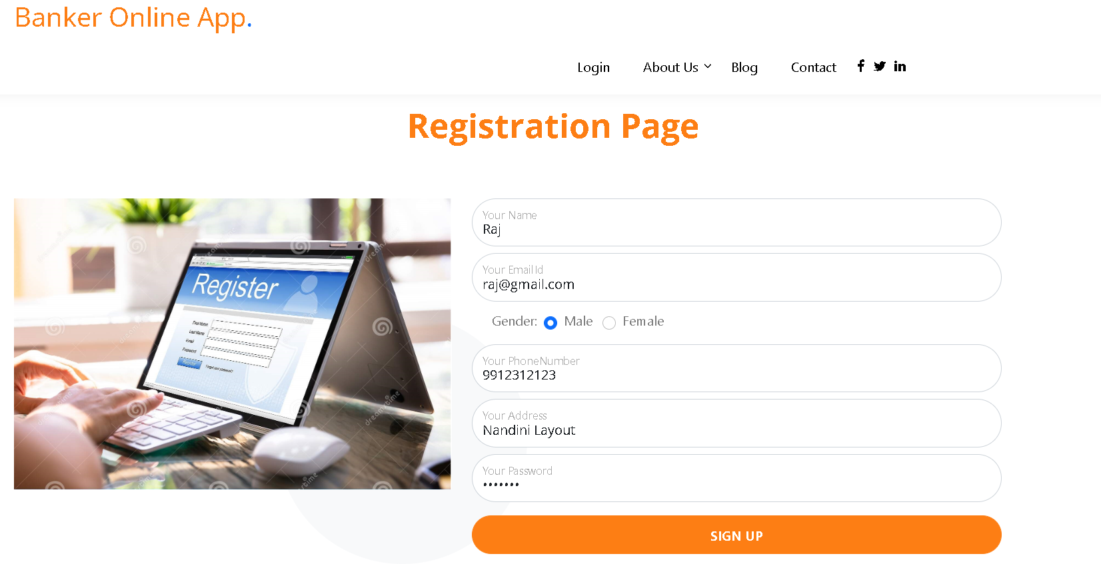
After fill the details

Slide 24
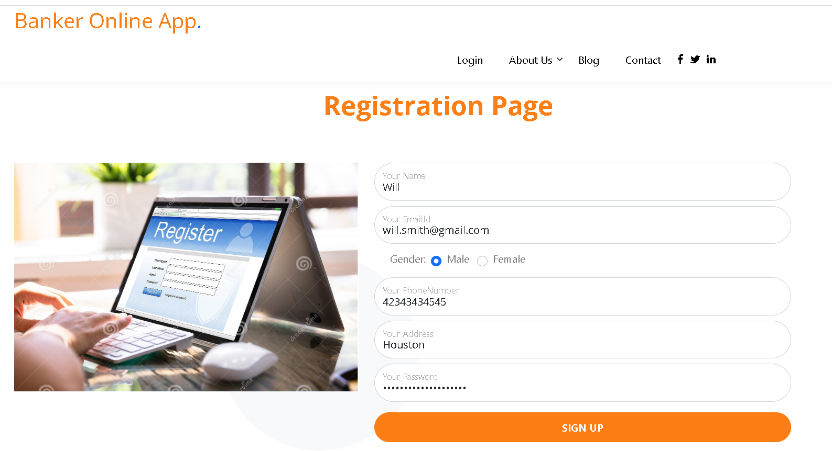
After fill all details

Slide 25
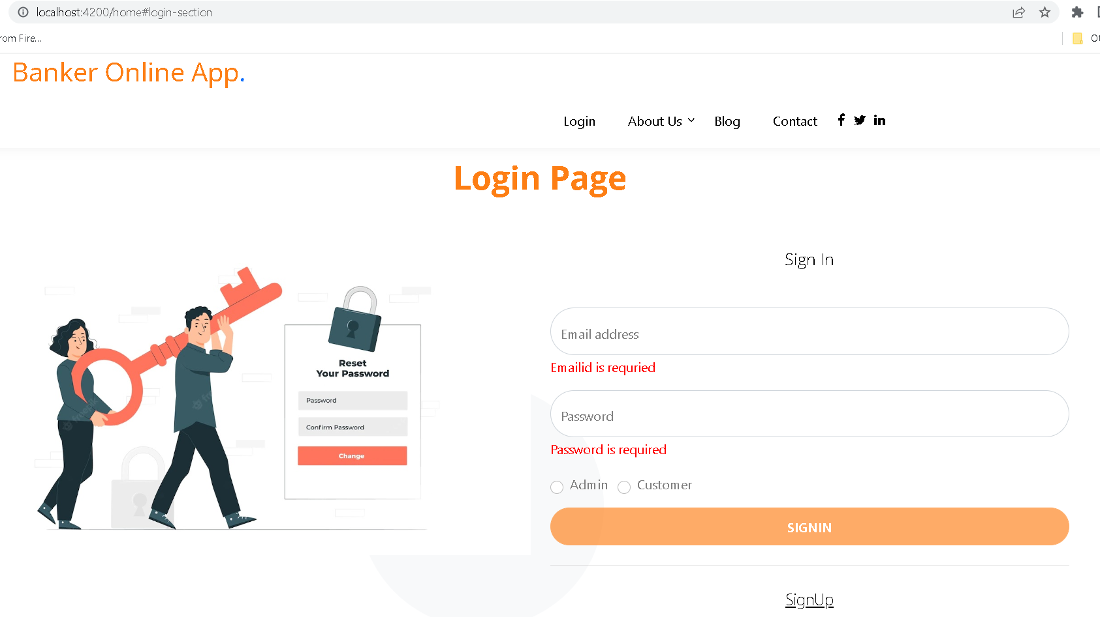
After created account now we can do login

Slide 26
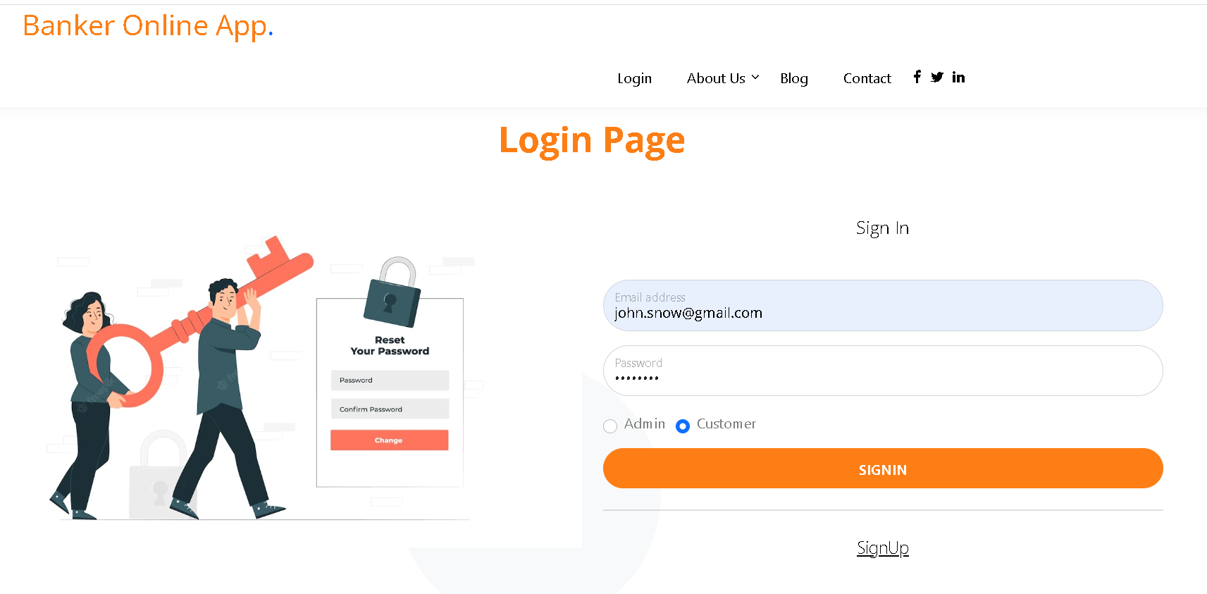
After fill customer login details

Slide 27
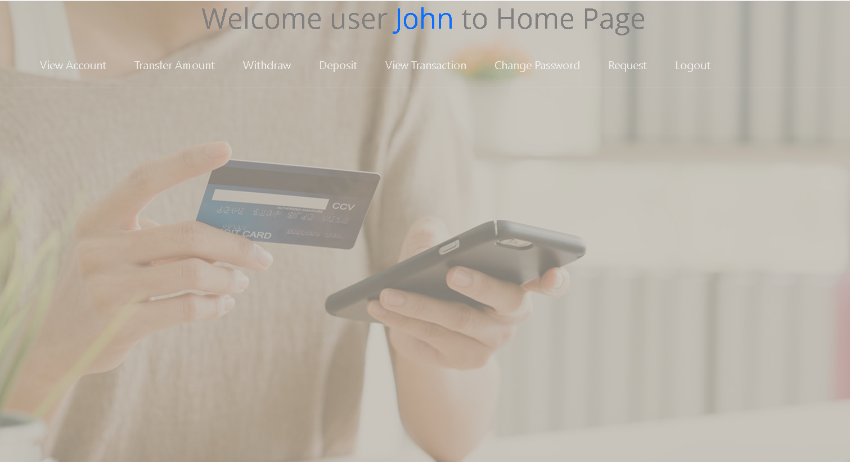
Customer home page

Slide 28
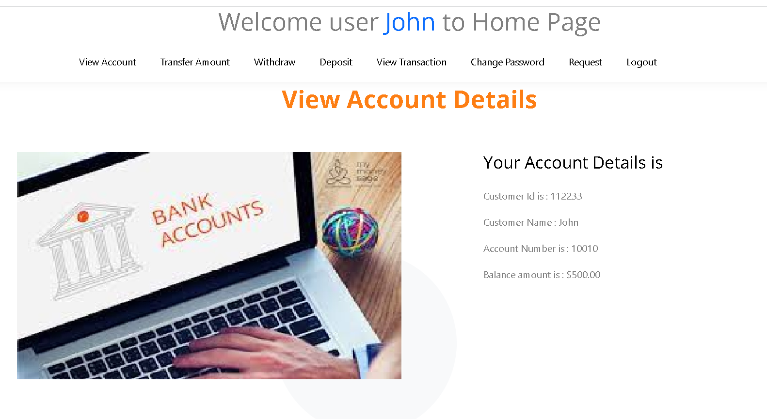
Customer account details – View account

Slide 29
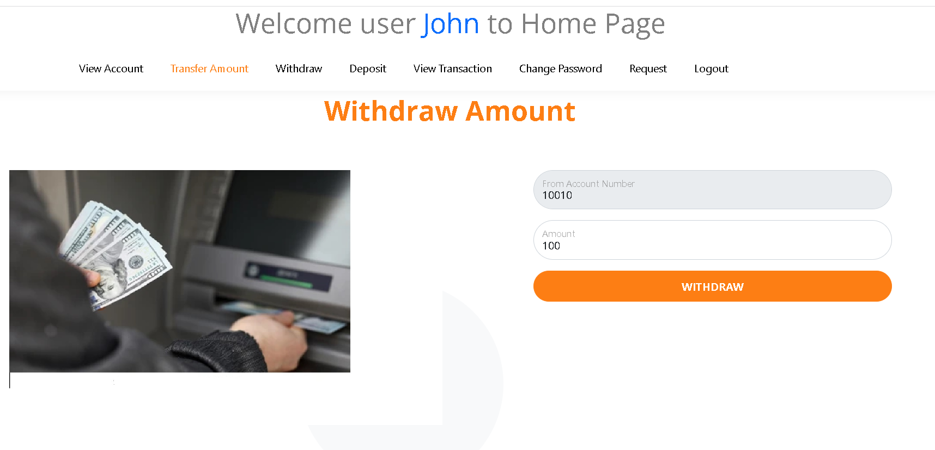
Withdraw amount

Slide 30
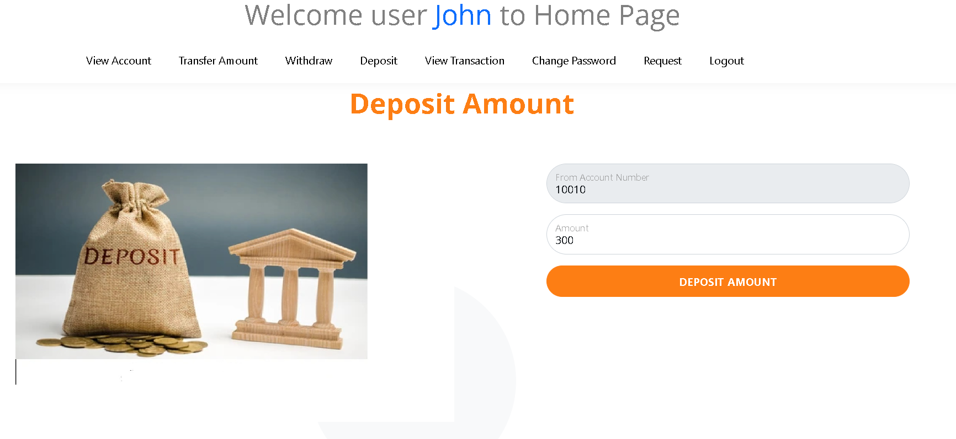
Deposit amount

Slide 31
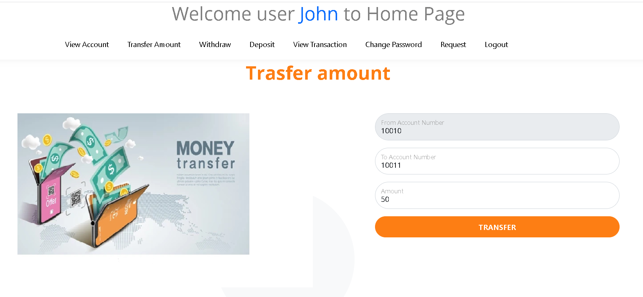
Transfer amount

Slide 32
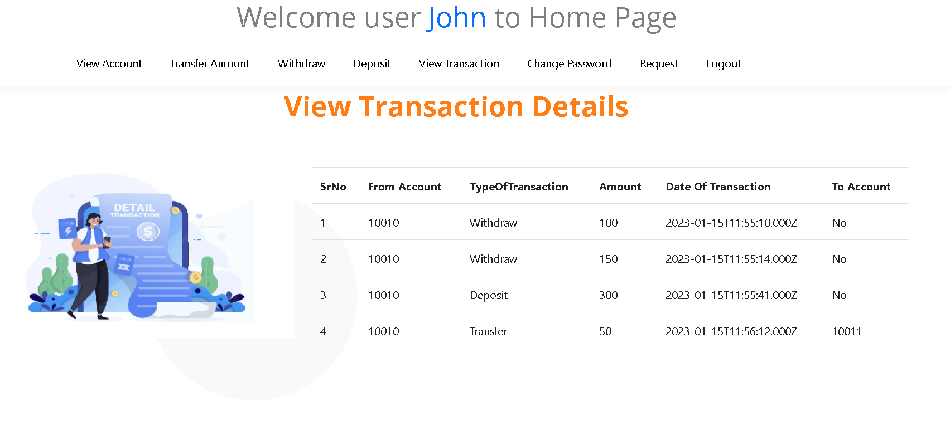
View its own transaction details

Slide 33
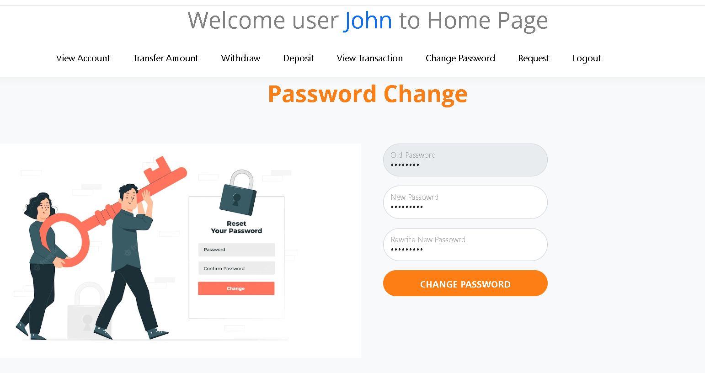
Customer change password

Slide 34
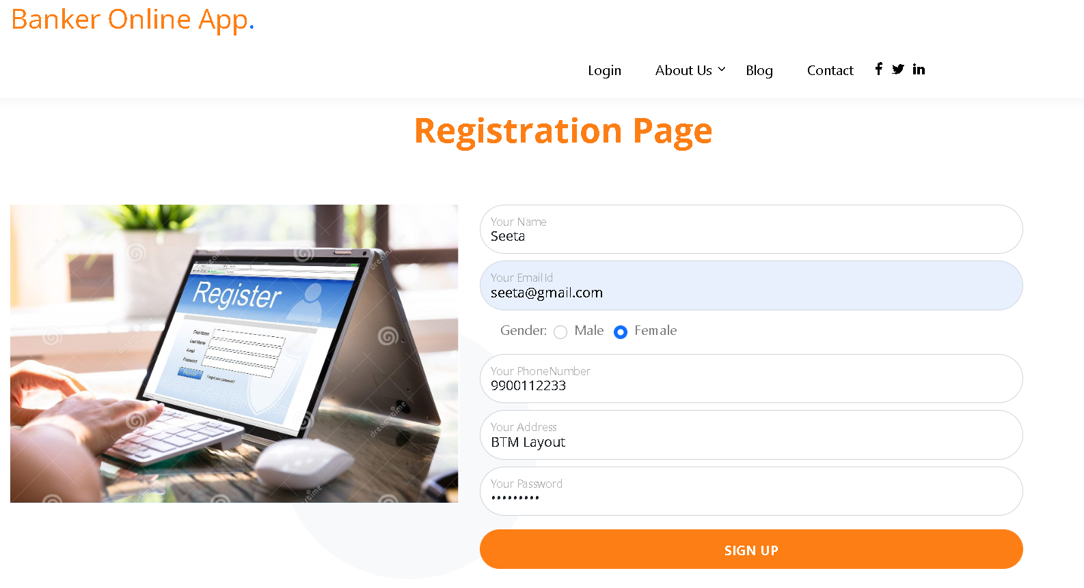
We will create more than one account

Slide 35
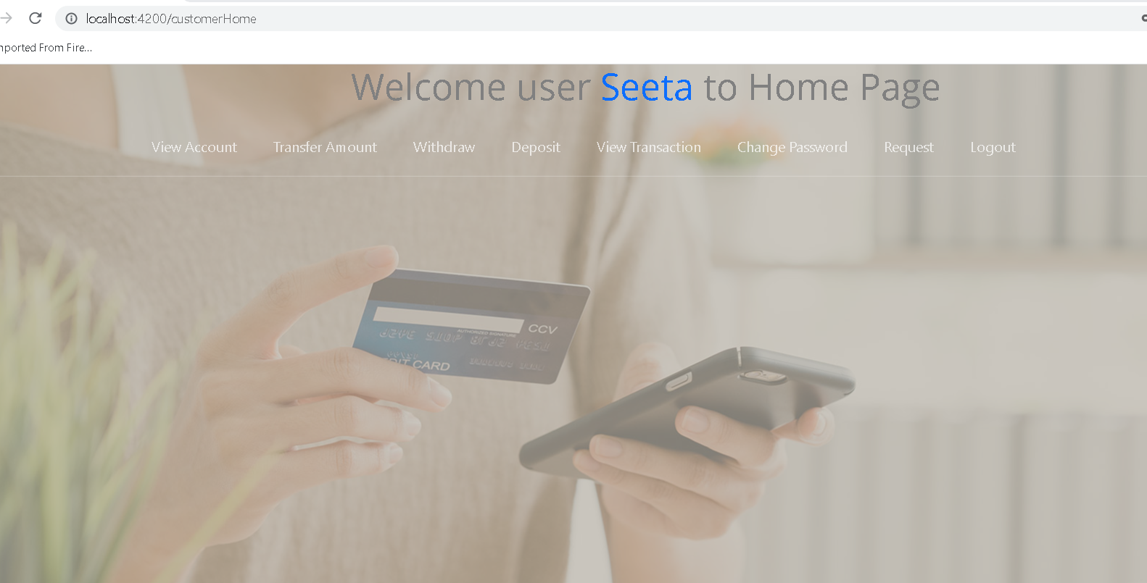
Login with another account

Slide 36
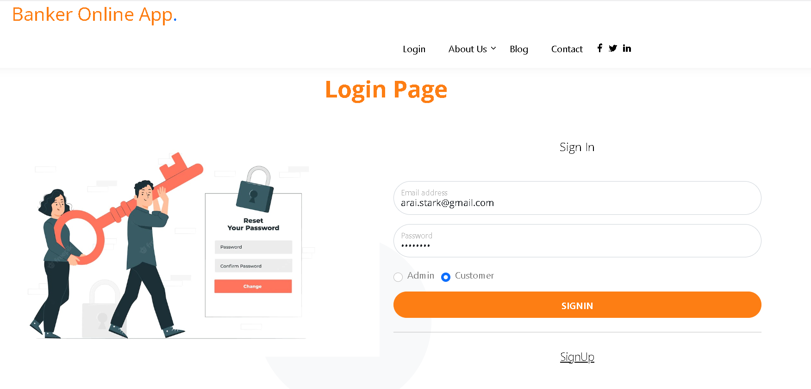
Login with another account

Slide 37
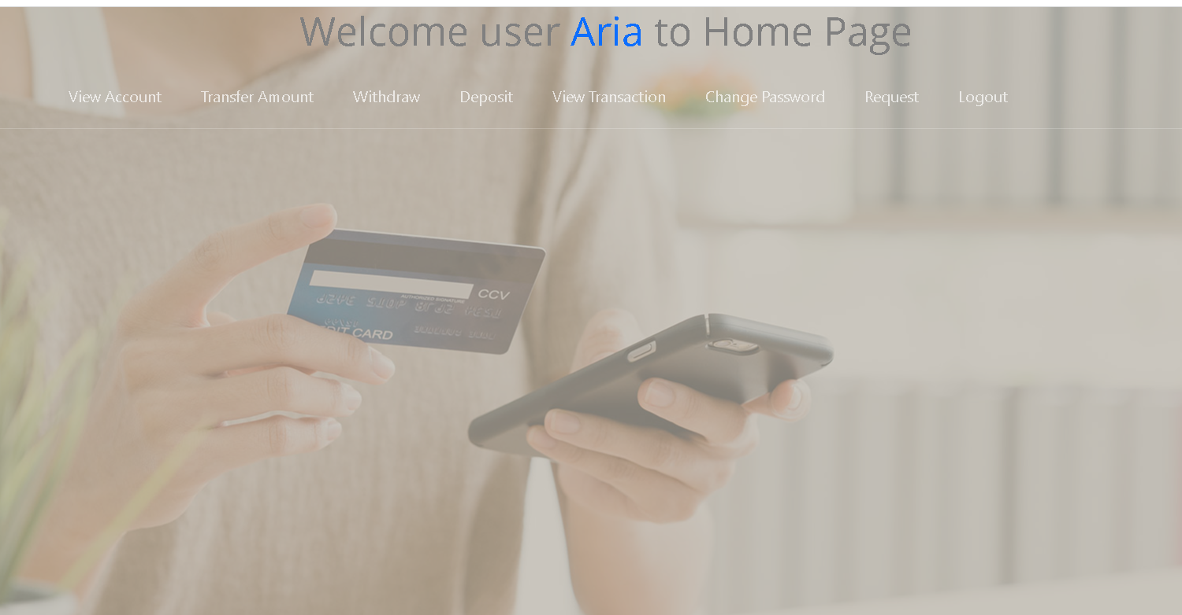
View its own details

Slide 38
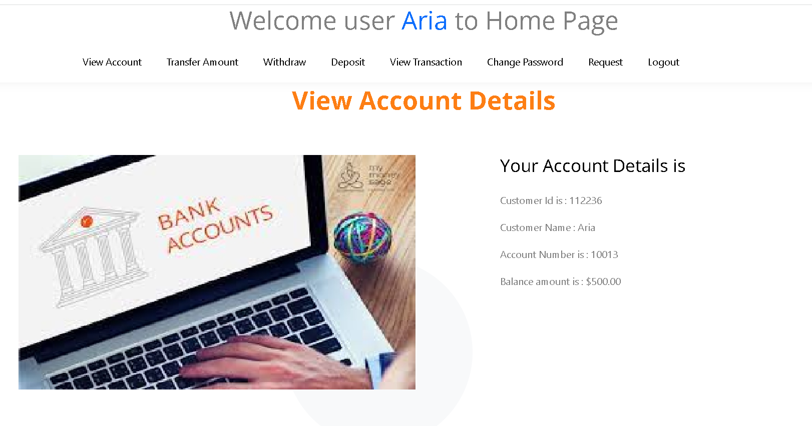
View its own account

Slide 39
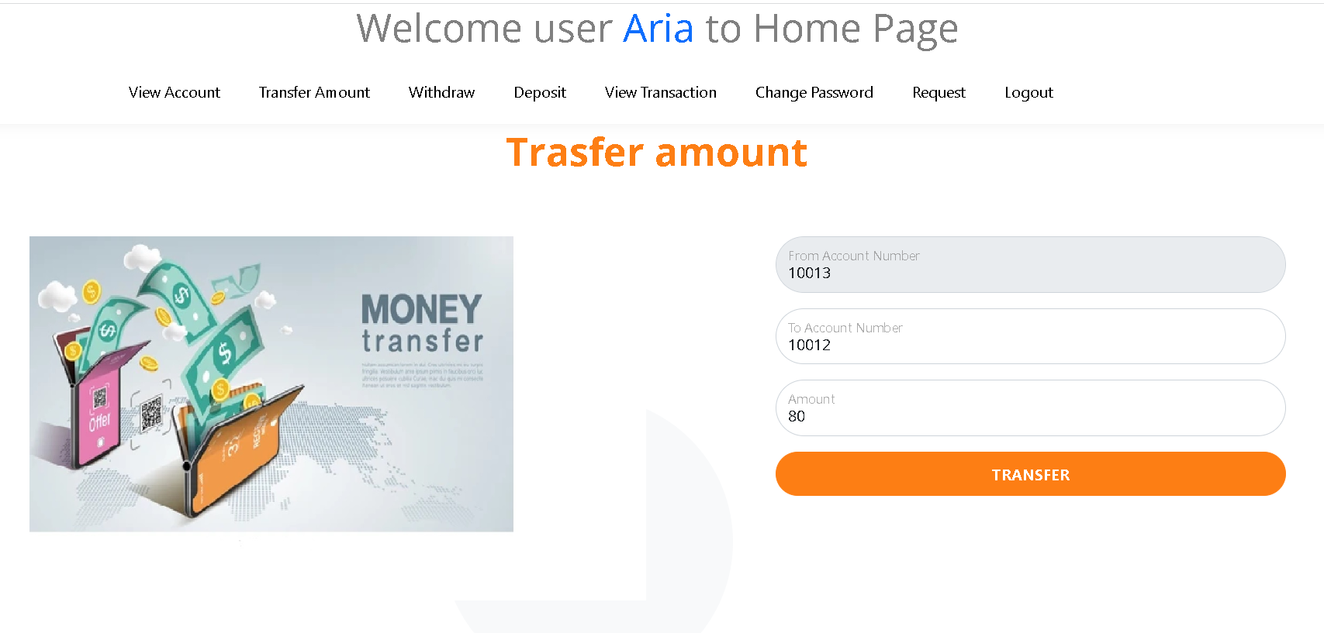
Do more withdraw and deposit operation

Slide 40
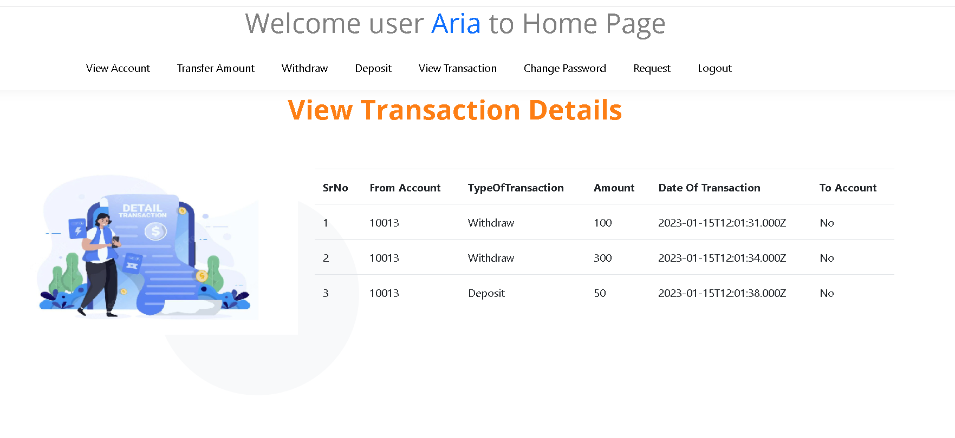
To check its own transaction details

Slide 41
Now we do the login using admin
username : admin@gmail.com
password : admin@123

Slide 42
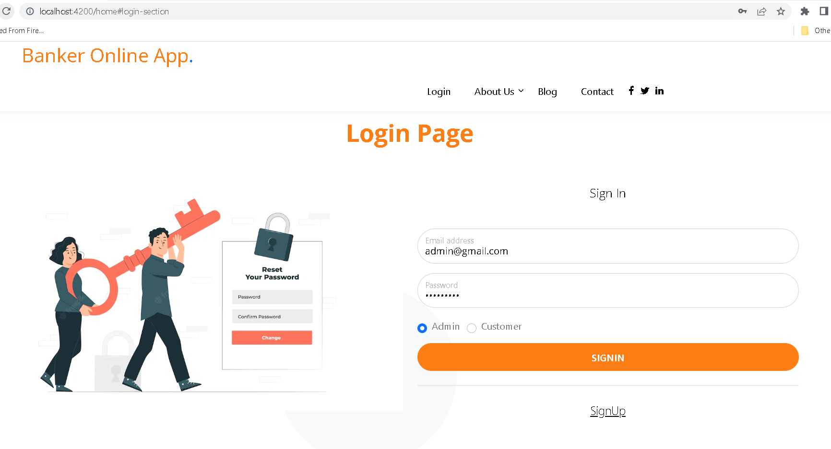

Slide 43
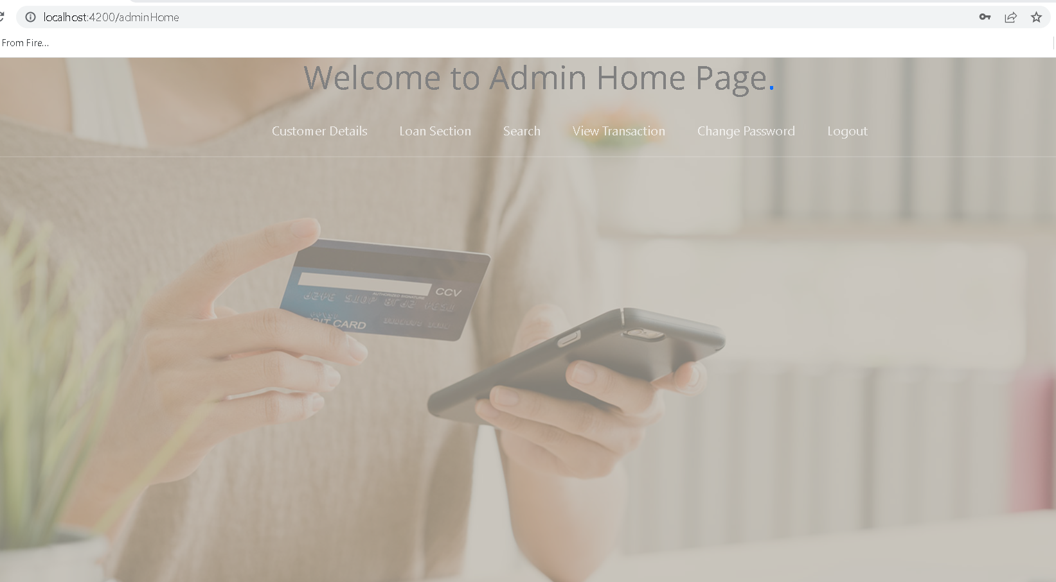
Admin dashboard

Slide 44
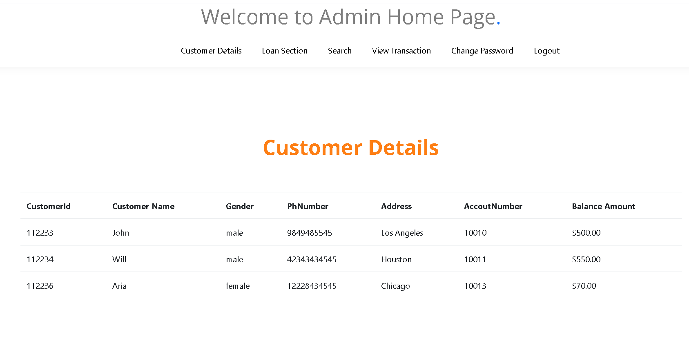
View all customer details

Slide 45
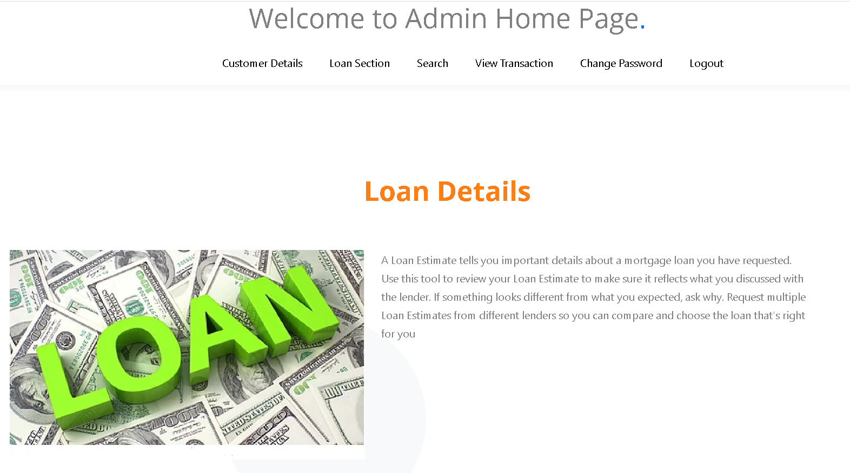
Loan section - static web page

Slide 46
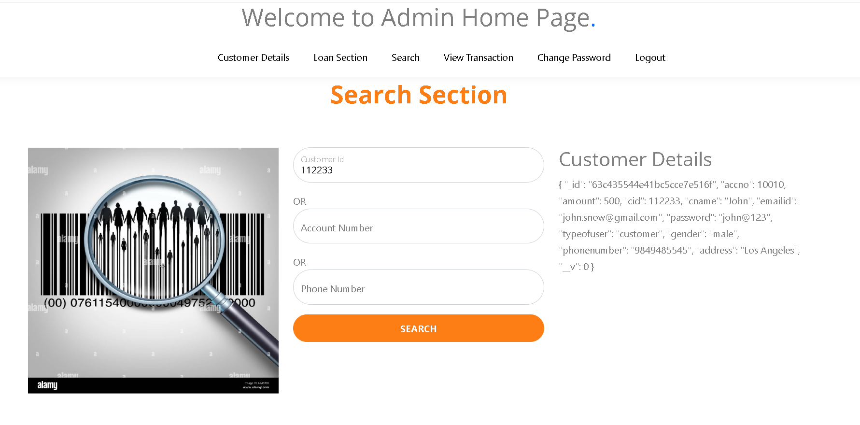
Search customer
By : customer id

Slide 47
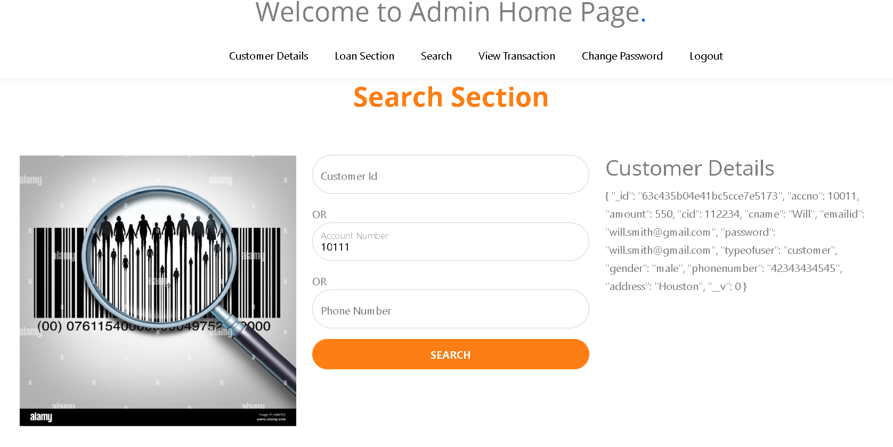
Search customer
By account number

Slide 48
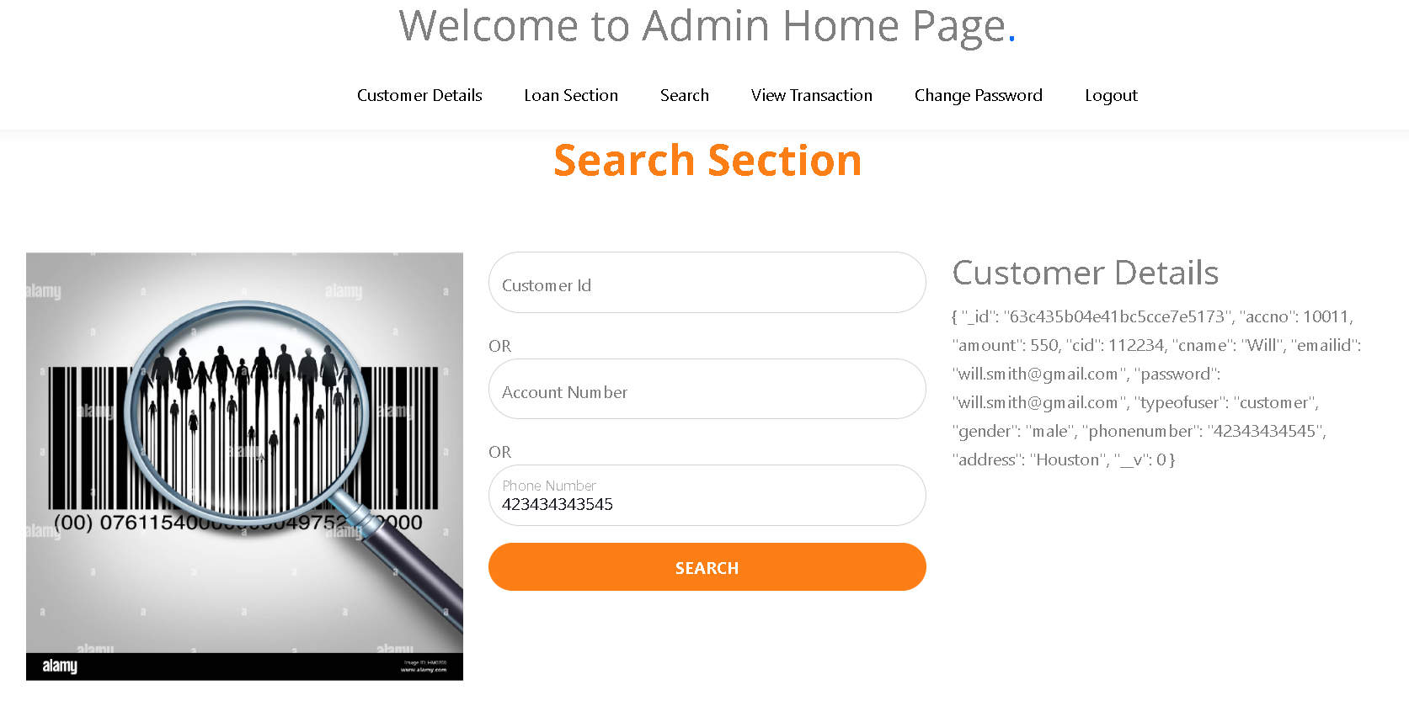
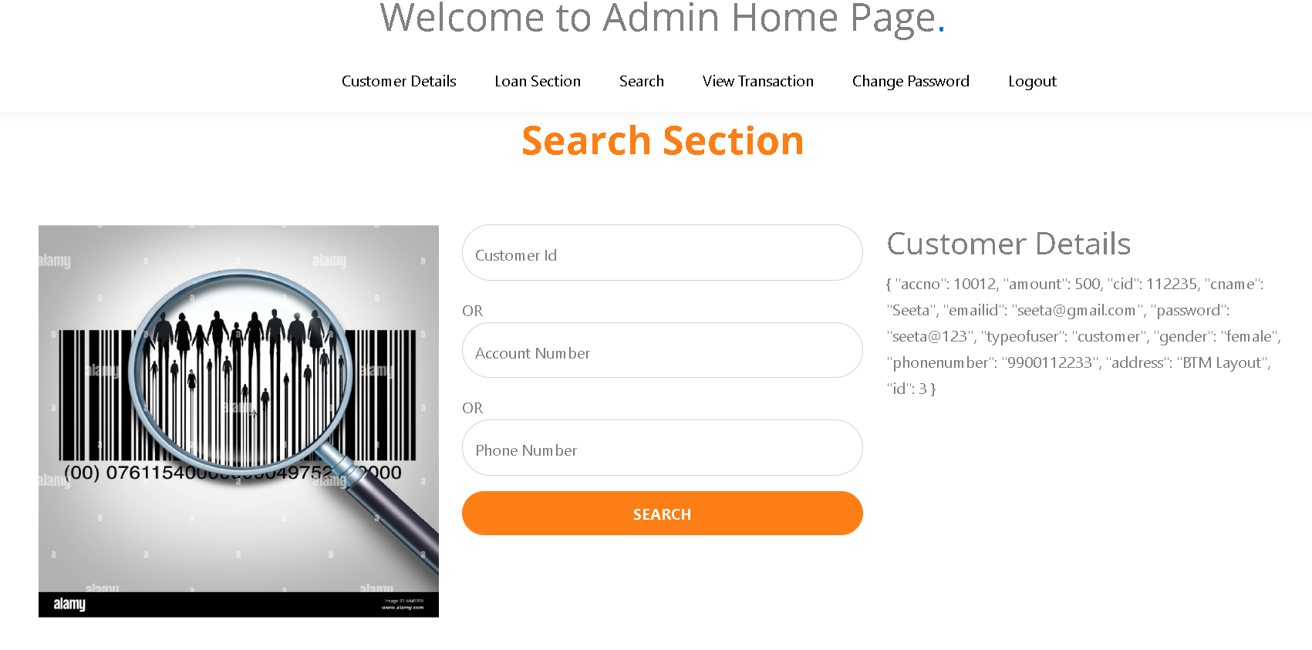
Search customer
By phone number

Slide 49
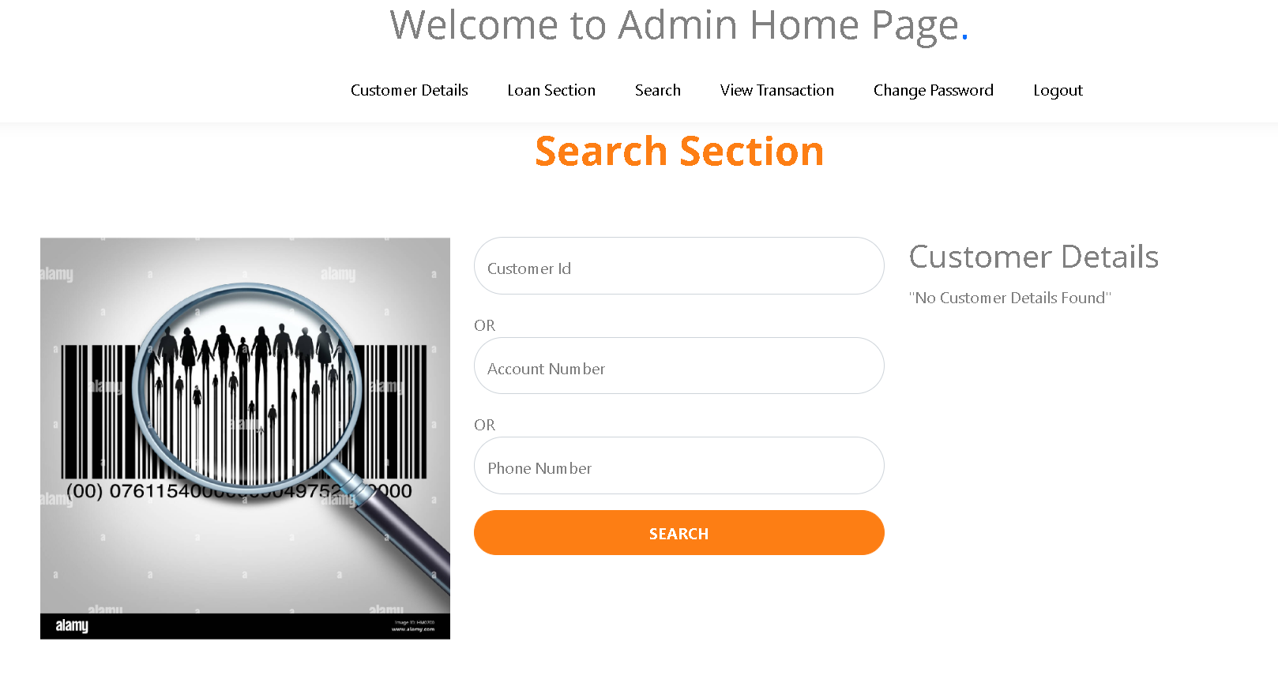
Search customer – not available

Slide 50
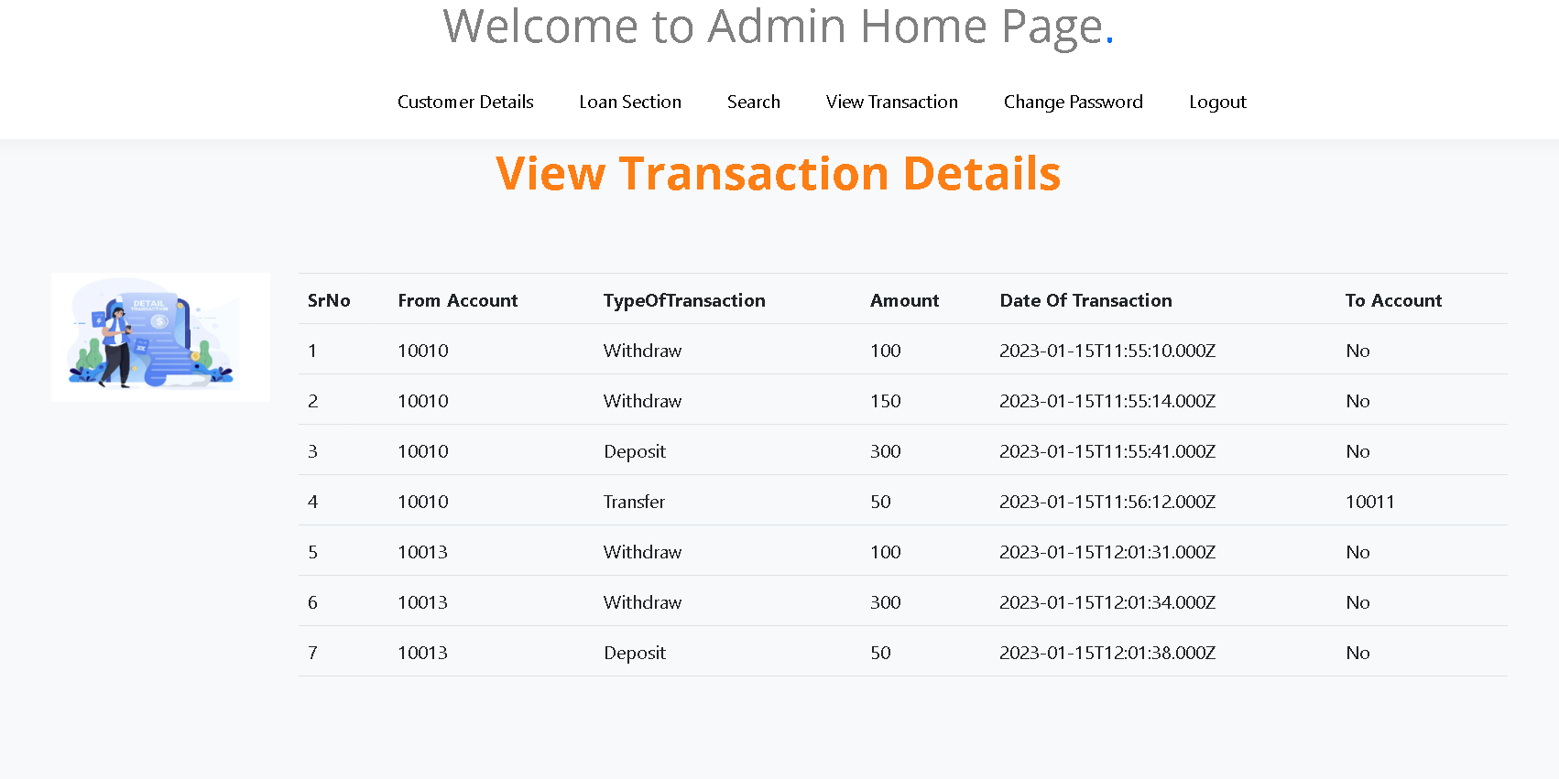
View all customer details

Slide 51
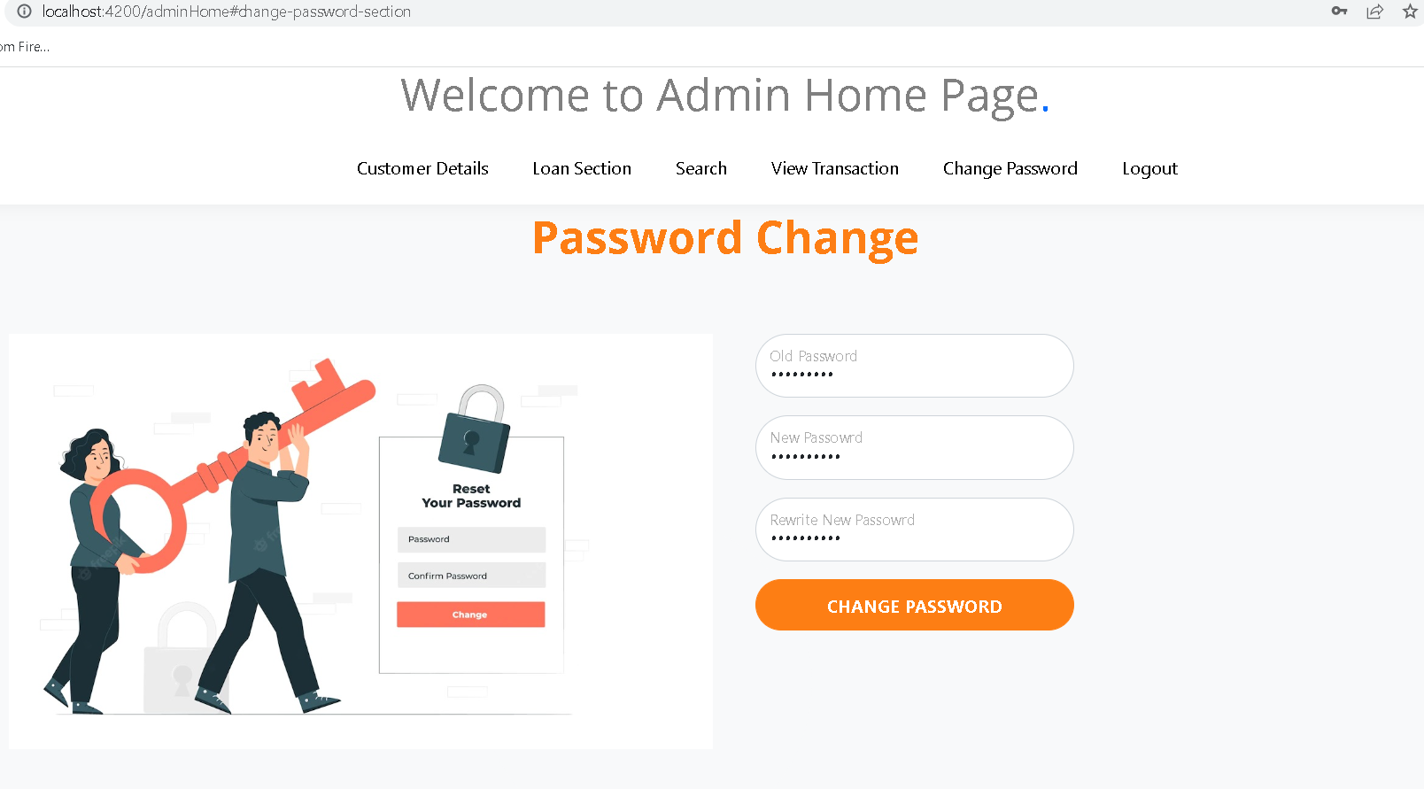
Change password

Slide 52
View all collection in mongo db database

Slide 53

db.Customer.find().pretty()

Slide 54

db.Admin.find().pretty()

Slide 55

db.Transaction.find().pretty();

